Slide 1
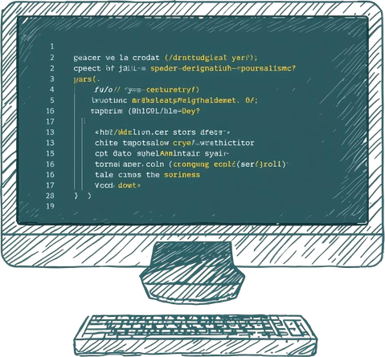



State-Based Step Tracker
(Multi Step Persistence Engine)
B.Tech CSE Semester II Project
By: [Kanishk Singh ]
Roll NO - 150096725104 / JEFF BEZOS

Slide 2
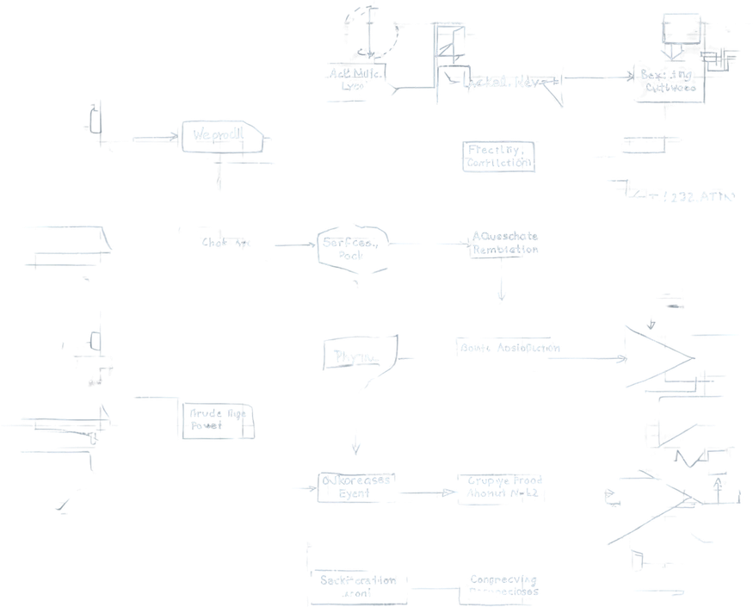


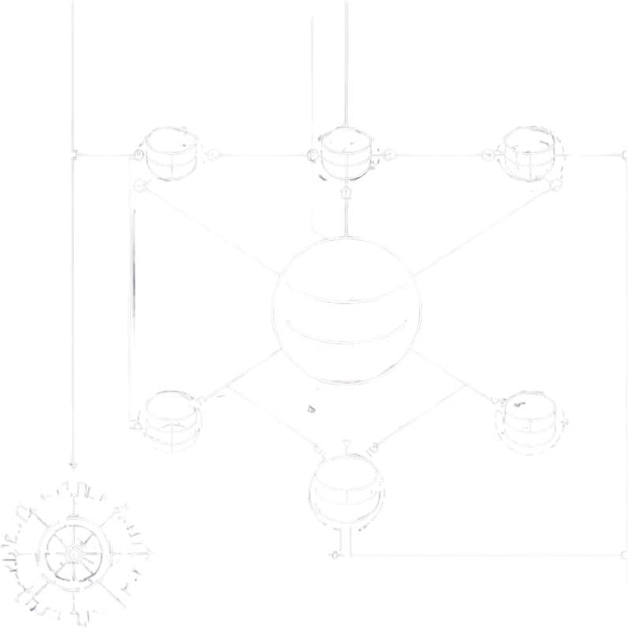
1 . Problem Statement
The Issue: Traditional web forms lose all entered data and user progress if the page is accidentally refreshed.
The Impact: Causes frustrating user experiences, abandoned checkouts, and repetitive data entry.
The Goal: Build a front-end system that tracks progress and saves input data without needing a back-end server or database.

Slide 3

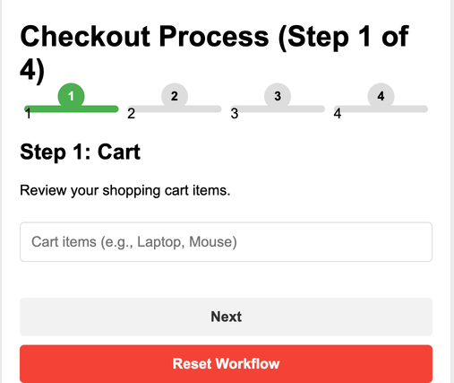
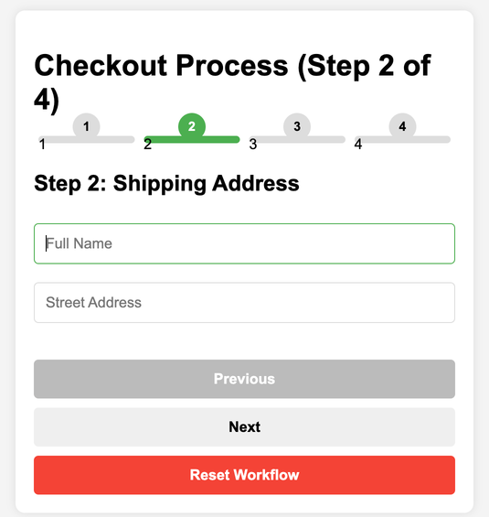
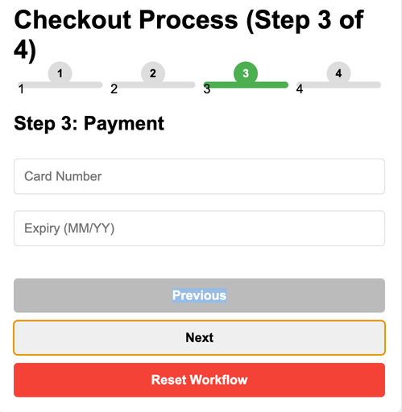
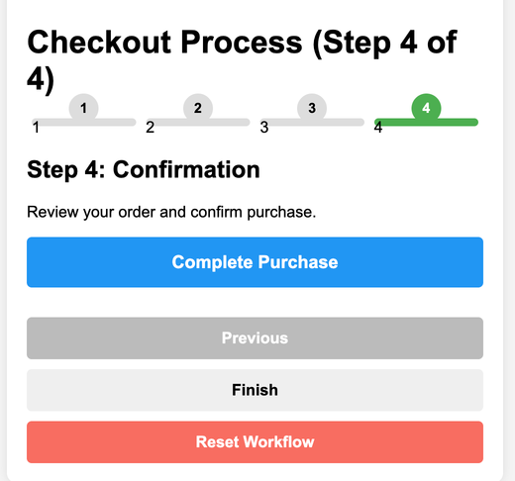

2 . YOUR SOLUTION
Multi-Step Workflow Concept: I designed a 4-step e-commerce checkout flow (Cart ➔ Address ➔ Payment ➔ Confirmation). Instead of loading 4 separate HTML pages, it's one dynamic page.
Dynamic UI: JavaScript is used to hide inactive steps and only display the current step, creating a seamless, app-like experience instantly.

Slide 4

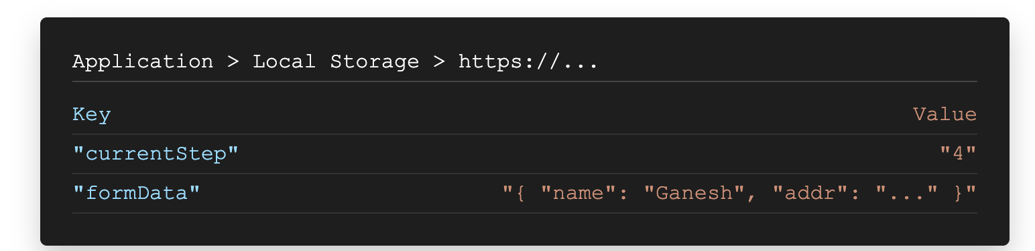

3. Working (Method/Mind map)
Navigation Model: Users progress using "Next" and "Previous" buttons.
Strict boundary checks prevent moving past Step 4 or below Step 1.
State Persistence Logic: Every time a user types or clicks "Next", JavaScript saves the currentStep index and form data (using JSON.stringify) directly into the browser's localStorage.
.
Restore Lifecycle: When the page loads (or reloads), a loadStep() function instantly runs.
It retrieves data from localStorage, parses it, and dynamically renders the exact step and inputs the user left off at.

Slide 5


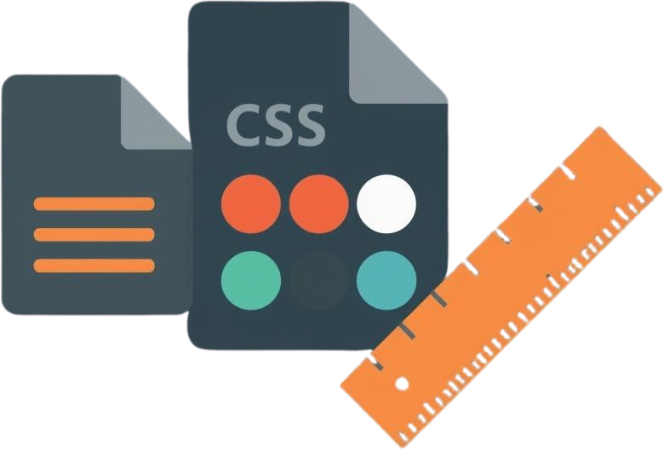

4. Conclusion
Goal Achieved: Successfully built a state-persistent workflow using JavaScript, HTML5, and CSS3.
Key Takeaway 1: localStorage is an essential API for seamless user continuity on the front end.
Key Takeaway 2: Isolating state logic from DOM rendering creates clean, maintainable, and bug-free code.
Result: Lightning-fast navigation with zero page reloads required.

Slide 6
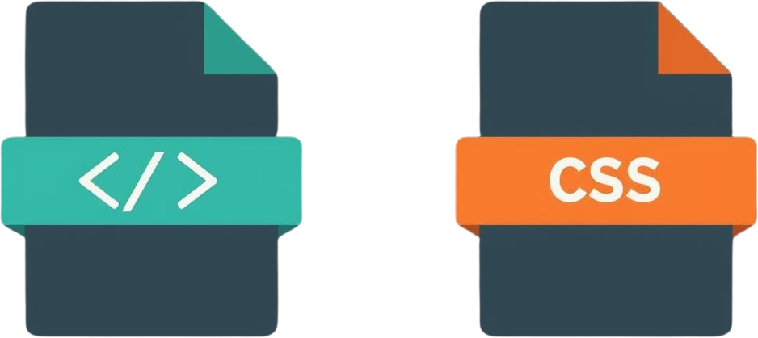

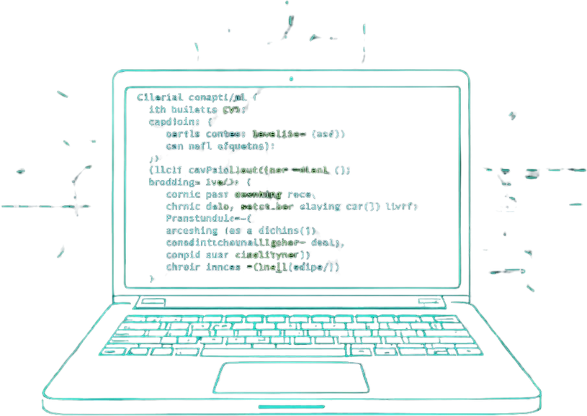
Thank You
For Reviewing This Project
MAde by - KAnishk Singh

